Slide 1
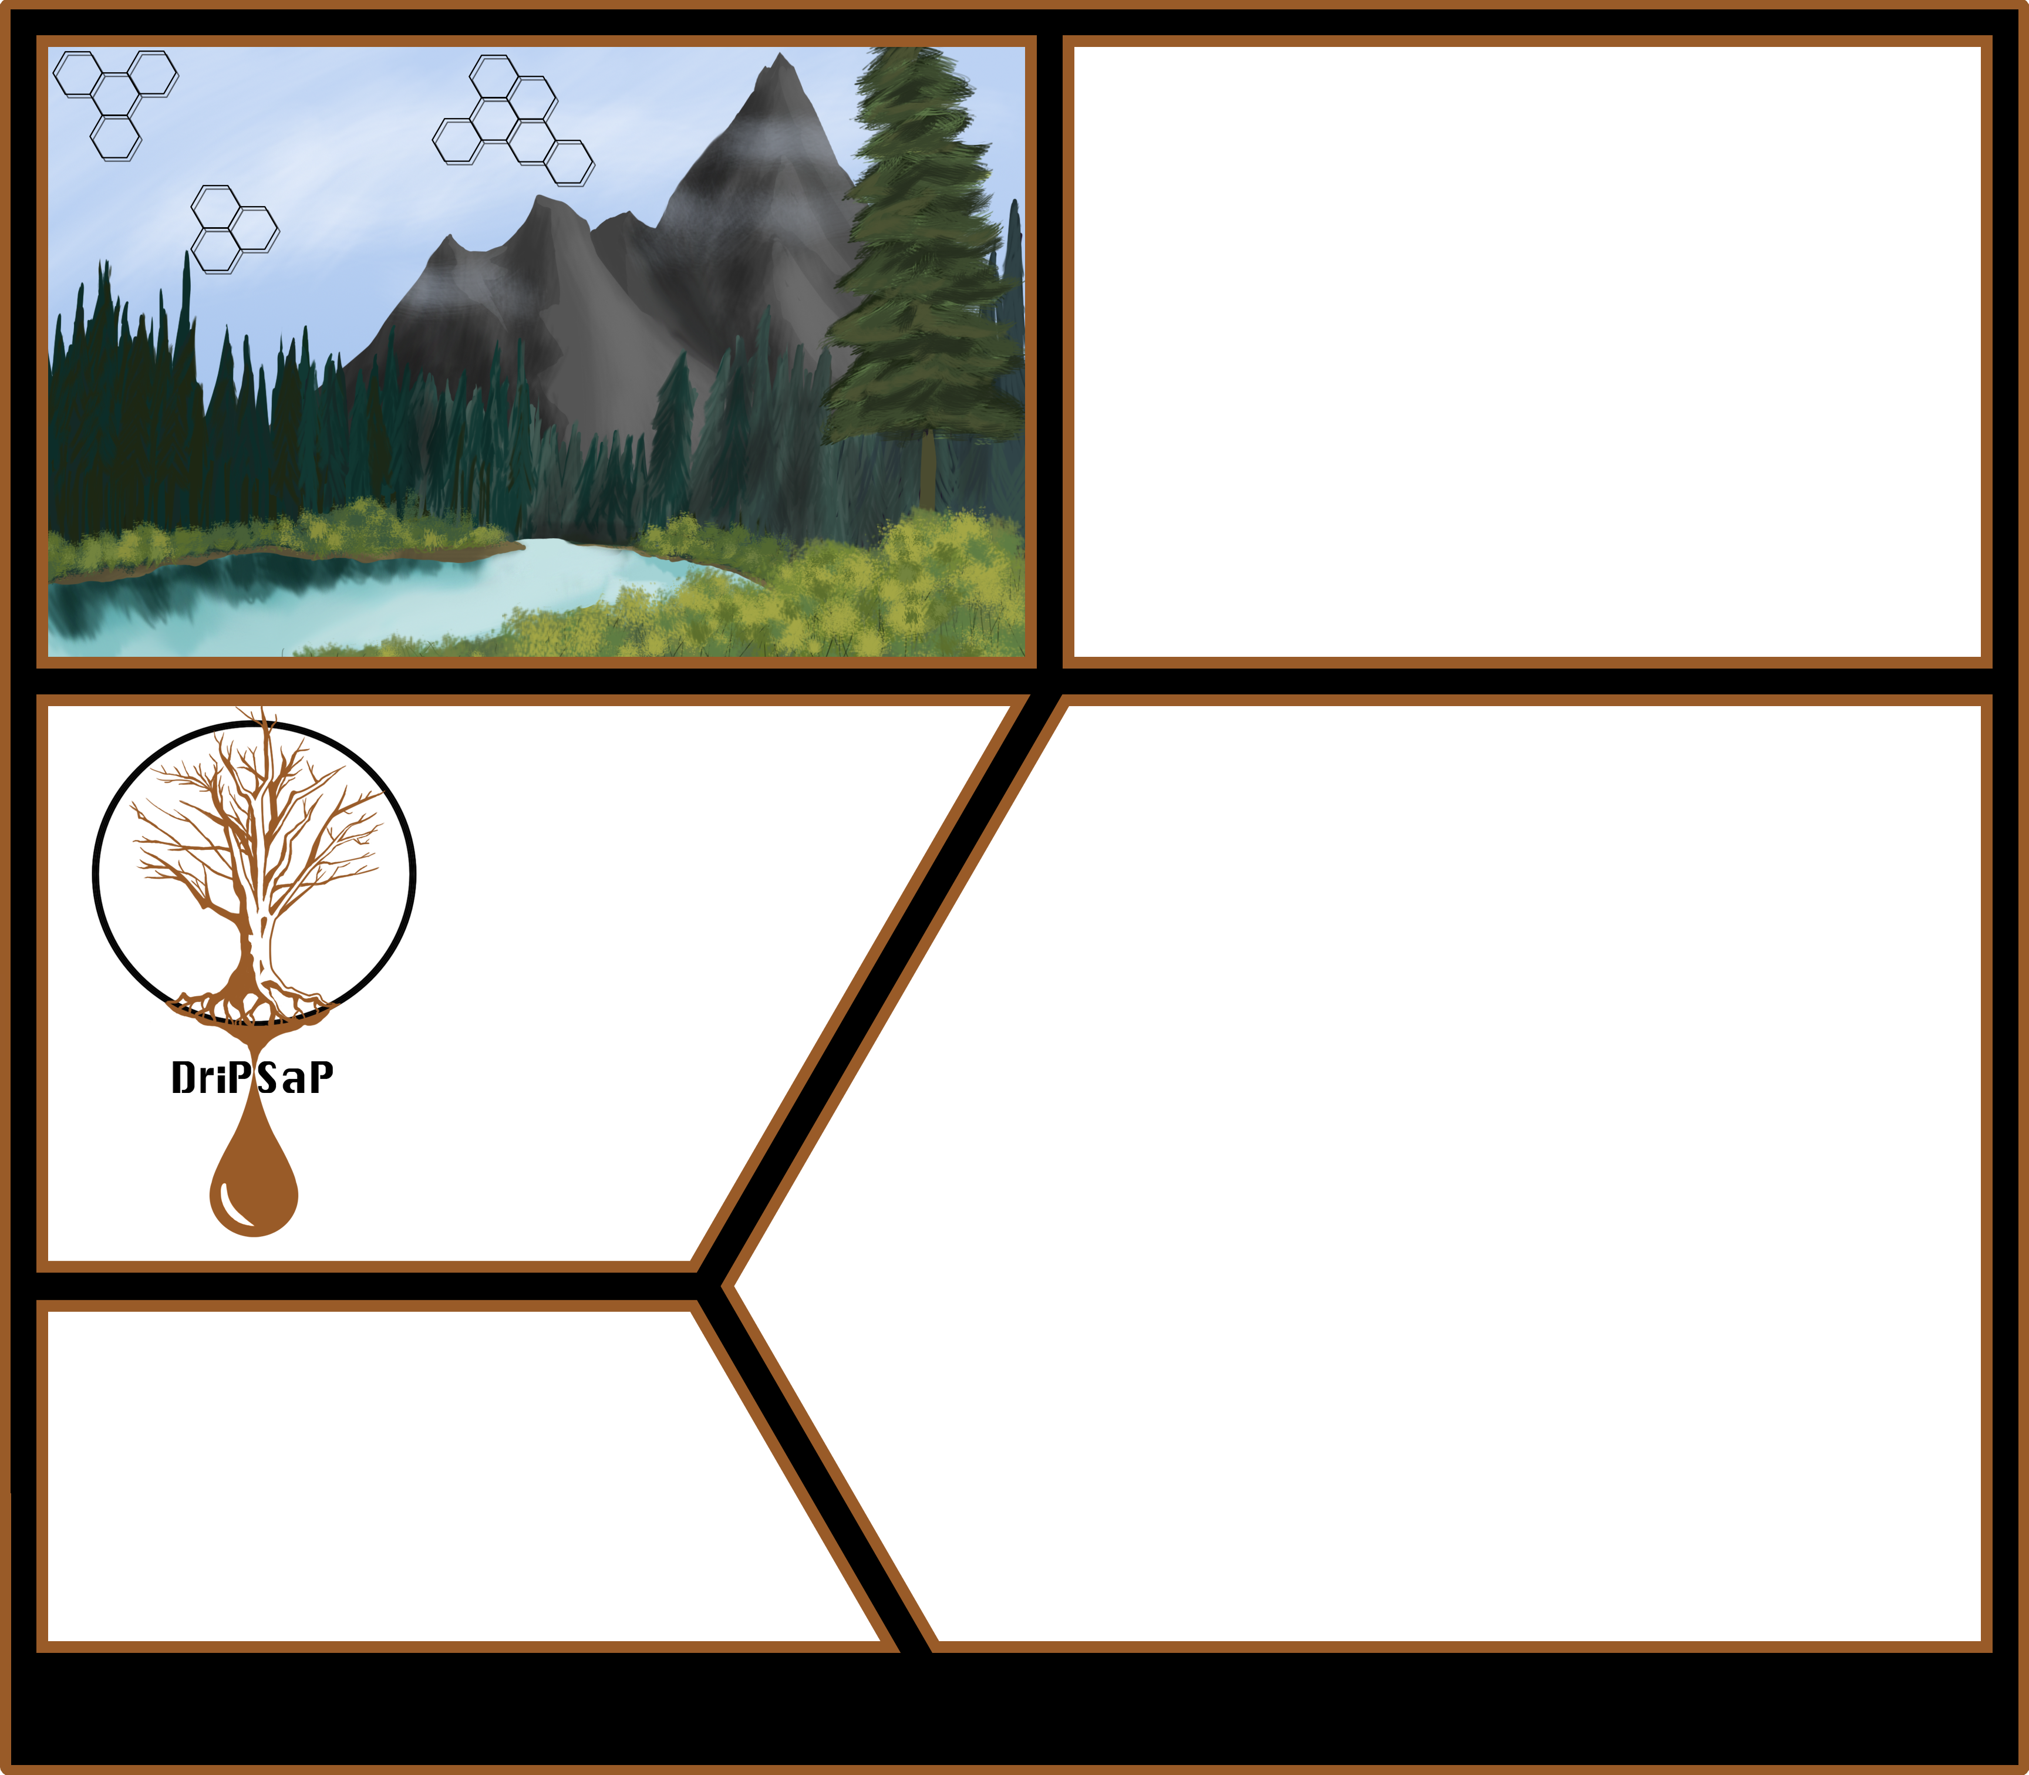
Setting
The vast, and largely unsettled, realm of Kaodith is a diverse land dotted with lakes, mountains, vast plains, and thick forests. Once settled by an advanced people, now long disappeared, much of Kaodith is ripe for the taking. Mysterious mines lie undisturbed only waiting to be activated for the riches to flow, and secrets are found around every corner. Coming to this land, your people have entrusted you with the mantle of leadership. They have entrusted you with their protection; their fate is in your hands. A rival kingdom nearby threatens to take your lands. To prevail, you must rally your people, and prepare for war.
Realm of
Kaodith
Team DriPSaP
Andrew Buelow
Mario Carneiro
Kyle Donovan
Sam Gutentag
Stephen Hara
What is Realm of Kaodith?
Realm of Kaodith is a complex turn based strategy game where players strive to defeat their opponent by destroying the enemy’s fortress. Each turn, the player will issue orders from their fortress in an effort to destroy their enemy while preserving their own base. The
citizens of Kaodith can be called on for battle or work as conscripts and workers. Powerful warriors and wizards wielding arcane might can be recruited and trained within the fortress. Heroes ranging from soldiers of
light to paid mercenaries offer an array of abilities. As lord of the realm, the player manages the movement and strategy of their troops across their lands
Kingdom of the
Red Phoenix
while seeking and destroying the enemy fortress. The player can upgrade their fortress into a mighty citadel, upon which great buildings may be constructed turning the fortress into a weapon of mass destruction or a
beacon of strength. No single strategy will win a given game, and players will face crucial choices when choosing a path. Through exploration, expansion, and combat, only one will rule the Realm of Kaodith.
VS.
Dominion of the
Blue Dragon
Computer Science and Engineering – The Ohio State University

